Slide 1

Project Title: Implement Anomaly Detection Sample
Supervised By: Damir Dobric / Prof. Dr. Andreas Pech
Group Name: Team_Anomaly_Detection
Members:
Mahbubur Rahman
Md Zihadul Islam Joni
Md Rakibul Islam

Slide 2
Overview
Introduction
Implementation
Results
Conclusion
References
Project Objective

Slide 3
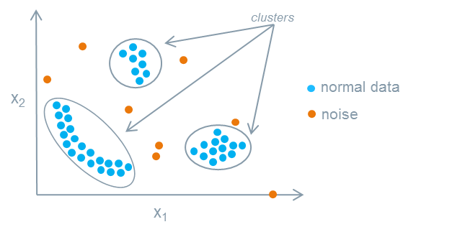
WHAT IS ANOMALY? Deviations from the expected value of an event within a group
Anomaly detection is an important technique used in many fields and applications. A recent trend in the field is that more and more applications and systems are being built to detect anomalies continuously in real time. Detection of anomalies is a major issue that has been studied for centuries, but it is only recently that there has been an increase in the number of methods for detecting these outliers. Numerous distinct methods have been developed and used to detect anomalous patterns for different applications. An example of medical application is heart rate monitors, where a shock at a certain interval indicates an irregular rhythm. Other examples include fraud detection, loan application processing or monitoring of medical conditions, cyber security intrusion detection systems that monitor server logs for abnormal activities, fault detection for aviation safety studies
Introduction

Slide 4

HTM (Hierarchical Temporal Memory) is a machine learning algorithm that processes time-series data in a distributed manner using a hierarchical network of nodes. Each nodes, or columns, can be trained to learn, and recognize patterns in input data. This can be used in identifying anomalies/deviations from normal patterns. It is a promising method for predicting and detecting anomalies in a range of applications. In this project, we will train our HTM Engine using the multisequencelearning class in the NeoCortex API, and then use the trained engine to learn patterns and identify anomalies. Specifically, numerical sequences will be read from various CSV files inside a folder in order to create an anomaly detection system.
PROject objective

Slide 5
methodology
We are going to use multisequencelearning class of NeoCortex API as base of our project. It will help use with both training our HTM model and using it for prediction. The class works in the following way:
HTM Configuration is taken and memory of connections are initialized. After that, HTM Classifier, Cortex layer and HomeostaticPlasticityController are initialized.

Slide 6
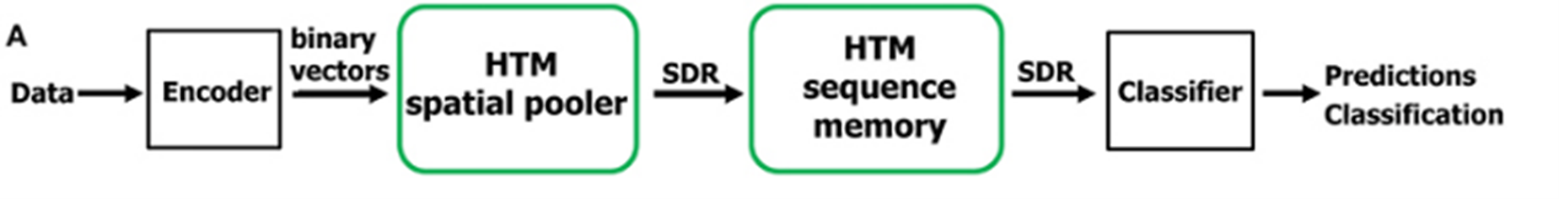
Methodology (Cont.)
Hierarchical Temporal Memory (HTM)
Machine learning algorithm based on the core principles of the Thousand Brains Theory.
Takes inspiration from neocortex of human brain.
Hierarchical Temporal Memory Cortical Learning Algorithm (HTM CLA): Tries to simulate the way neocortex processes information in human brain.
Can be used process information, recognize and identify patterns and make future predictions based on past learning.
Promising approach for anomaly detection and prediction in a variety of applications in sectors, such as healthcare, finance, etc.
6

Slide 7
Methodology (Cont.)
Multisequence learning
Htm cla is good is finding patterns in data
We are using neocortex api, specifically multisequence class, which is based on htm cla.
Multiple number of sequences can be trained with different datatypes.
We are going to use simple numerical integer sequences.
We have to tune hyper-parameters, like encoder and htmconfig, which facilitates training this type of data.

Slide 8
Methodology (Cont.)
Anomaly detection
We have taken an artificially generated dataset and trained our htm engine.
We have added anomalies to random indexes in our prediction data.
We will try to train our data and detect anomalies using trained htm engine.

Slide 9
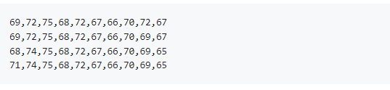

Execution of Project
Firstly, we will read and train the HTM Engine using the data from both our training (learning) and predicting (predictive) folders, which are present as numerical sequences in CSV files in the 'training' and 'predicting' folders inside the project directory. Normally, the values stay within the range of 65 to 75.
All values outside of this range are considered anomalies for testing purposes. However, in order to identify anomalies, we have a csv file in the predicting folder. Typically, some of the data in this file does not fall within 65 and 75.

Slide 10
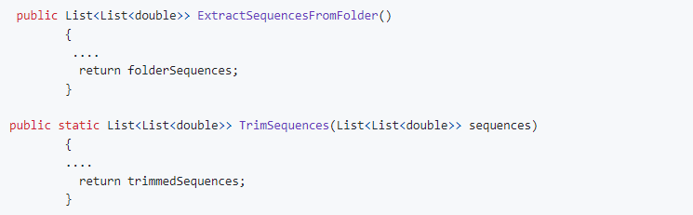
Execution of Project (Cont.)
In the beginning, we have the Extract Sequences From Folder method of CsvSequenceFolder class to read all the files placed inside a folder.

Slide 11
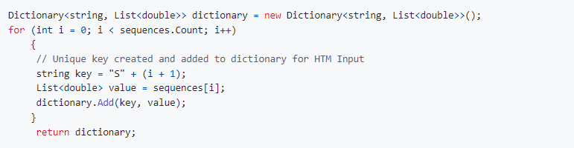
Execution of Project (Cont.)
After that, the method ConvertToHTMInput of CSVToHTMInputConverter class is there which converts all the read sequences to a format suitable for HTM training.

Slide 12
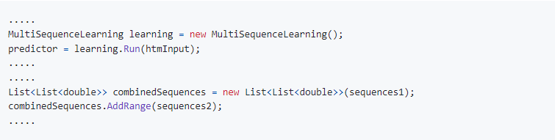
Execution of Project (Cont.)
After that, we have ExecuteHTMModelTraining method of HTMTrainingManager class to train our model using the converted sequences.

Slide 13
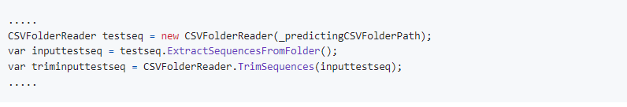

Execution of Project (Cont.)
In the end, we use HTMAnomalyExperiment to detected anomalies in sequences read from files inside predicting folder. All the classes explained earlier- CSV files reading (CsvSequenceFolder), combining and converting them for HTM training (CSVToHTMInputConverter) and training the HTM engine (using HTMTrainingManager) will be used here.
Path to training and predicting folder is set as default and passed on the constructor, or can be set inside the class manually.

Slide 14
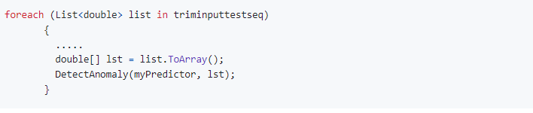

Execution of Project (Cont.)
In the end, DetectAnomaly method is used to detect anomalies in our trimmed sequences one by one, using our trained HTM Model predictor.
DetectAnomaly is the main method from ExtractSequencesFromFolder class which detects anomalies in our data. It traverses each value of a list one by one in a sliding window manner, and uses trained model predictor to predict the next element for comparison.

Slide 15
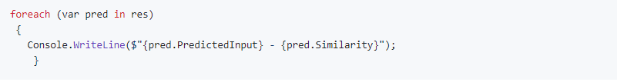
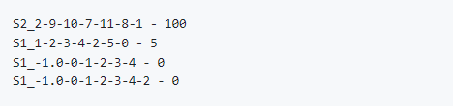
Execution of Project (Cont.)
Here, assume that item passed to the model is of int type with value 8. We can use this to analyze how prediction works. When this is executed,
We get the following output.

Slide 16
Execution of Project (Cont.)
We will then use this to detect anomalies.
When we iteratively pass values to DetectAnomaly method using our sliding window approach, we will not be able to detect anomaly in the first element. So, in the beginning, we use the second element of the list to predict and compare the previous element (which is the first element). A flag is set to control the command execution; if the first element has anomaly, then we will not use it to detect our second element. We will directly start from second element. Otherwise, we will start from first element as usual.
Now, when we traverse the list one by one to the right, we pass the value to the predictor to get the next value and compare the prediction with the actual value. If there's anomaly, then it is outputted to the user, and the anomalous element is skipped. Upon reaching to the last element, we can end our traversal and move on to next list.

Slide 17
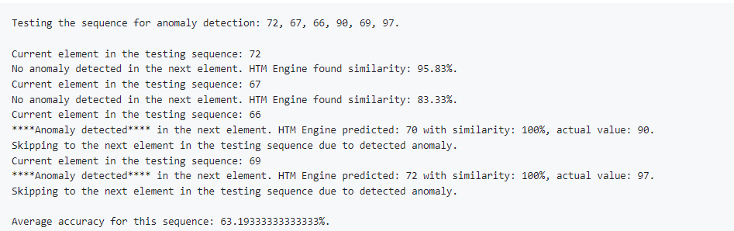
We can observe that the accuracy rate is between 50% - 70%. It is desired that high accuracy should on the sequence is required in an anomaly detection program. Due to hardware specification of our machine, we unable to run the program with lots of cycle and sequence. However, accuracy can be improved by running more data sequence and cycle.
One example of testing sequence for anomaly detection and average accuracy for this sequence given below:
results

Slide 18
conclusion
Low False Negative Rate (FNR) is crucial in anomaly detection, particularly in sensitive areas like fraud detection, to avoid overlooking anomalies and wasting resources on unnecessary investigations.
Hierarchical Temporal Memory (HTM) stands out for real-time anomaly detection without pre-training, making it ideal for dynamic data streams and resilient to noise.
Enhanced computational resources and time allocation, potentially through cloud platforms, can optimize HTM model performance by allowing for more data and hyperparameter tuning in anomaly detection applications.

Slide 19
references
[1] Y. Cui, S. Ahmed, and J. Hawkins, “The HTM Spatial Pooler—A Neocortical Algorithm for Online Sparse Distributed Coding,” Front. Comput. Neurosci. November 2017, vol. 11-2017, doi: 10.3389/fncom.2017.00111.
[2] Ahmad, S., Lavin, A., Purdy, S., and Agha, Z. (2017). Unsupervised real-time anomaly detection for streaming data. Neurocomputing 262, 134–147. doi: 10.1016/j.neucom.2017.04.070.
[3] Mnatzaganian, J., Fokoué, E., and Kudithipudi, D. (2017). A mathematical formalization of hierarchical temporal memory's spatial pooler. Front. Robot. AI 3:81. doi: 10.3389/frobt.2016.00081.
[4] K. Mountcastle, V. B. (1997). The columnar organization of the neocortex. Brain 120, 701–722. doi: 10.1093/brain/120.4.701.
[5] Olshausen, B. A., and Field, D. J. (2004). Sparse coding of sensory inputs. Curr. Opin. Neurobiol. 14, 481–487. doi: 10.1016/j.conb.2004.07.007.
[6] Y. Cui, S. Ahmed, and J. Hawkins, “Continuous online sequence learning with an unsupervised neural network model,” Neural Computation, Volume 28, Issue 11, November 2016, pp 2474–2504, doi: 10.1162/NECO_a_00893

Slide 20

Thank you

